Slide 1

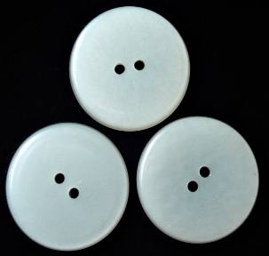
6-4 NOUNS: SINGULAR AND PLURAL
one
button
three
buttons

Slide 2
6-4 NOUNS: SINGULAR AND PLURAL
SINGULAR
PLURAL
(a) one button
one banana
one card
one ant
two button
six banana
three card
four ant
s
s
s
s
add -s

Slide 3
6-4 NOUNS: SINGULAR AND PLURAL
SINGULAR
PLURAL
(e) wish
watch
glass
box

Slide 4
6-4 NOUNS: SINGULAR AND PLURAL
SINGULAR
PLURAL
(e) wish
watch
glass
box
wish
watch
glass
box
es
es
es
es
-sh, -ch, -ss, -x
add -es

Slide 5
6-4 NOUNS: SINGULAR AND PLURAL
SINGULAR
PLURAL
(b) one baby
two babies
consonant + -y
y to i, add -es

Slide 6
6-4 NOUNS: SINGULAR AND PLURAL
SINGULAR
PLURAL
(b) one baby
one party
two bab
six part
ies
y
ies
y

Slide 7
6-4 NOUNS: SINGULAR AND PLURAL
SINGULAR
PLURAL
(c) one toy
six toys
vowel + -y
add -s

Slide 8
6-4 NOUNS: SINGULAR AND PLURAL
SINGULAR
PLURAL
six toy
three ray
(c) one toy
one ray
s
s

Slide 9
6-4 NOUNS: SINGULAR AND PLURAL
SINGULAR
PLURAL
(d) one wife
two wives
-f or -fe
f to v, add -es

Slide 10
6-4 NOUNS: SINGULAR AND PLURAL
SINGULAR
PLURAL
(d) one wife
one life
two wi
two li
f
v
e
es
f
v
e
es

Slide 11
6-4 NOUNS: SINGULAR AND PLURAL
SINGULAR
PLURAL
tomato
potato
(f) tomato
potato
es
es
consonant + -o
add -es

Slide 12
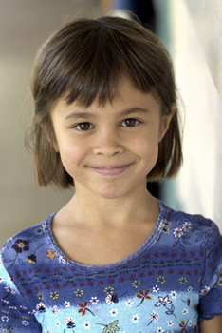
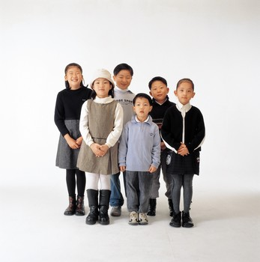
6-5 NOUNS: IRREGULAR PLURAL FORMS
One child
Six children

Slide 13
6-5 NOUNS: IRREGULAR PLURAL FORMS
SINGULAR
PLURAL
(a) child
(b) foot
(c) man
(d) mouse
(e) tooth
(f ) woman
(g) person
children
feet
men
mice
teeth
women
people

Slide 14
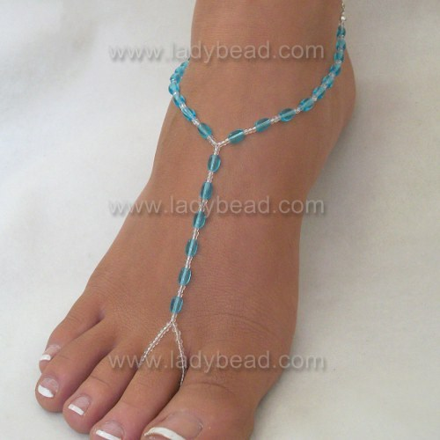
It is a foot.
They are feet.

Slide 15
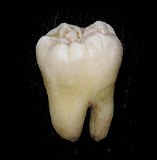
It is a tooth.
They are teeth

Slide 16
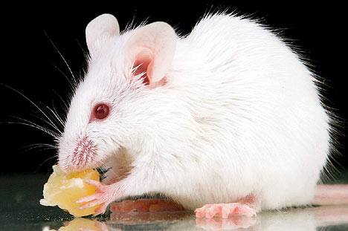
They are mice
It is a mouse.

